Slide 1
Data Structures and Algorithms

Slide 2
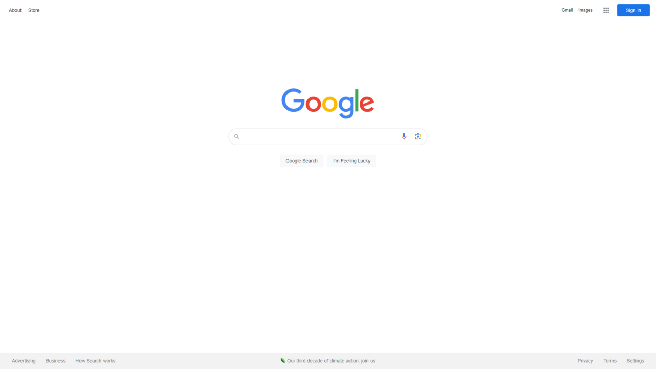

Web Browsers
Social Media Algorithms

Slide 3
Contents
Introduction to Time Complexity
Searching Algorithms
Linear search
Binary search
Hash table search
Sorting Algorithms
Insertion Sort
Bubble Sort
Quick Sort
Merge Sort
Data Structures
Stack
Queue
Linked List
Binary Tree
Binary Search Tree

Slide 4
Introduction to Time Complexity
What is time complexity?
Describes the amount of computer time it takes to run an algorithm.
Measured using the Big-O Notation!
etc. O(n), O(log n), O(n²)
We will go through the different time complexities as we learn the various algorithms ;)

Slide 5
Linear Search
Source: https://www.tutorialspoint.com/data_structures_algorithms/images/linear_search.gif

Slide 6
Linear Search
Most basic form of searching a particular value from an array
Start from the start of the list/array, move through the list until a particular value is found.
Returns the index where the value is found.
Time complexity: O(n) - linear
Worst case time complexity happens when the value is found at the last position of the array of size n.

Slide 7
Linear Search - Code
def linear_search(arr, target):
for i in range(len(arr)):
if arr[i] == target:
return i
return -1 # target cannot be found in array

Slide 8
Binary Search
Uses a divide and conquer approach
It will test the middle index of the list, and reject half of the list that does not contain the required value.
Array MUST be sorted, if not it will not work as intended.
Time complexity: O(log n) - logarithmic

Slide 9
Binary Search
Target = 41

Slide 10
Binary Search - Code
def binary_search(arr, target):
low, high = 0, len(arr) - 1
while low <= high:
mid = (low + high) // 2
if arr[mid] == target: # target found
return mid
elif arr[mid] < target: # target is positioned at the right side of the array
low = mid + 1
else: # target is positioned at the left side of the array
high = mid - 1
return -1 # not found

Slide 11
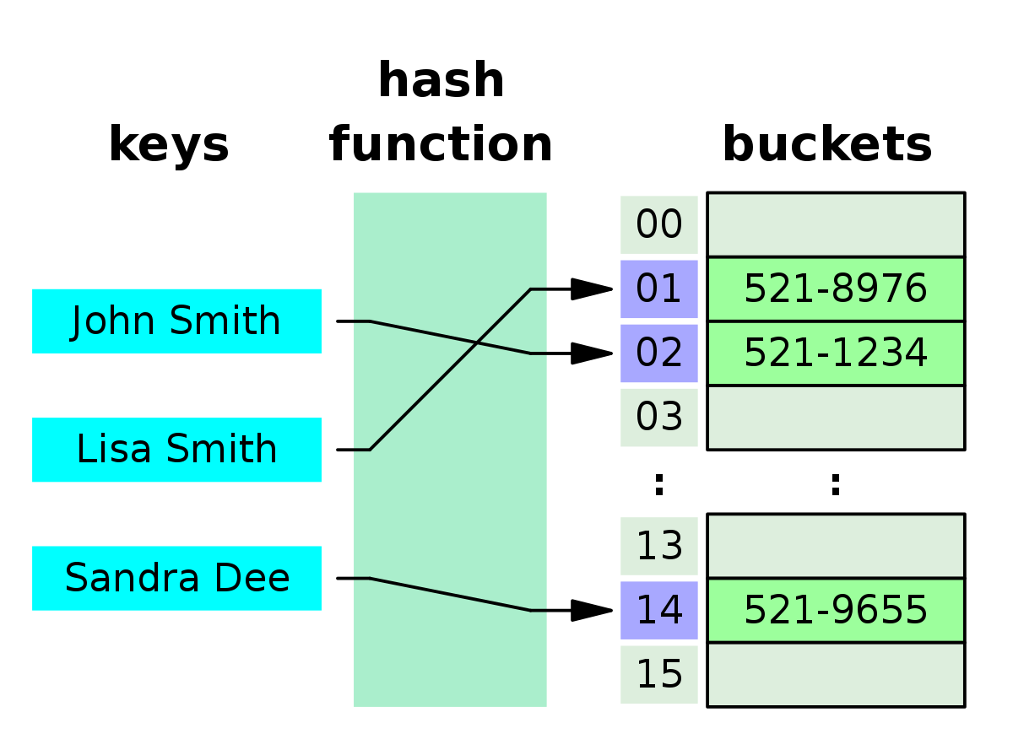
Hash Table Search
What is a hash table?

Slide 12
Hash Table Search
In order to store a key-value pair in a hash table, we have to hash the key first.
Hashing is the process of mapping keys to an index in the hash table.
Sample hash function:
def hash(key):
return sum(ord(char) for char in key) % len(hash_table)
* preferably modulus with a prime number to reduce collisions.

Slide 13
Hash Table Search
The hash function in the previous slide has a time complexity of O(len(key)) since we are processing the entire key using a for loop.
With a proper hash function, this is usually done in O(1) constant time.
A hash table search simply accepts the key and value and determines if the value at the key position matches the target using the hash function.

Slide 14
Hash Table Search - Code
hash_table = [None] * 11 # initialise a hash table with size 11
def hash(key):
total = 0
for i in range(len(key)):
total += ord(key[i])
return total % len(hash_table)
def search(key, value):
hashed_key = hash(key)
if hash_table[hashed_key] == value:
return hashed_key
return -1 # not found

Slide 15
Hash Table Search
Previously, I briefly stated that the calculated hash should modulo a prime number due to collisions.
A good hashing function will minimise the chance of occurring a collision.
Here are some guiding principles to a good hashing function:
The hashing function must be deterministic. This means that a given input will always produce the same output.
The hashing function must have uniformity. It should produce uniformly distributed outputs.
It must be one-directional. The original data cannot be retrieved from its hash.

Slide 16
Hash Table Search
However, all good hashing functions have a chance of encountering collisions.
As such, there must be measures to ensure that these collisions are handled gracefully.
There are three common types of collision handling methods used:
Linear probing
Quadratic probing
Chaining

Slide 17
Hash Table Search
Linear Probing

Slide 18
Insertion Sort
Insertion Sort builds the final sorted array one at a time.
There is an outer loop for i in range(len(arr)) and an inner loop. At the end of each outer loop, we preserve the invariant that index between 0 and i must be sorted. The inner loop removes arr[i] and find the correct position to its left to insert.
Time complexity: O(n²) - Quadratic

Slide 19
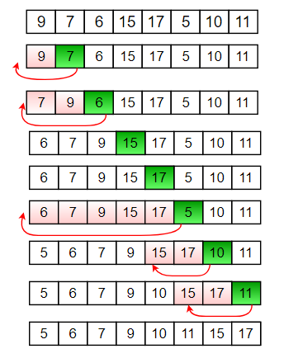

1 + 2 + 3 + 4 + … + (N-1) ≈
as N tends to infinity.
Source:
https://bteccomputing.co.uk/insertion-sort/

Slide 20
Insertion Sort - Code
def insertion_sort(arr):
res = arr[:] # creating a copy so that it does not modify the original array
for i in range(1, len(res)):
temp = res[i]
j = i - 1
while j >= 0 and temp < res[j]:
res[j+1] = res[j] # shift element at j to j+1
j -= 1
res[j+1] = temp # inserting temp to the correct position
return res

Slide 21
Bubble Sort
Bubble sort is the process of stepping through the list, comparing adjacent elements if they are in the correct order and swapping them if they are in the wrong order.
Bubble sort also possesses an invariant that at the end of the i-th iteration, the i-th maximum element will be in the correct position (at arr[-i-1]), as it bubbles up to the right, hence its name, "bubble sort" ;)
Time complexity: O(n²)

Slide 22
Bubble Sort
Let arr = [3, 5, 2, 1, 6, 4]
First iteration = [3, 2, 1, 5, 4, 6]
Second iteration = [2, 1, 3, 4, 5, 6]
…
Result = [1, 2, 3, 4, 5, 6]

Slide 23
Bubble Sort - Code
def bubble_sort(arr):
res = arr[:]
for i in range(len(res)):
for j in range(len(res)-1):
if res[j] > res[j+1]:
res[j], res[j+1] = res[j+1], res[j]
return res

Slide 24
Bubble Sort
Improvements that can be made:
For each iteration in the list, set a swap variable to False, if a swap occurs, set swap to True. After the iteration, if swap is False, it means that the array is already sorted, so return the result directly. (Best time complexity of O(n))

Slide 25
Quick Sort
Quick Sort selects a pivot from the array, and partition them into smaller subarrays based on their position relative to the pivot in a sorted array.
Time complexity: O(n log n) - Quasilinear
But the worst case time complexity for quicksort is O(n²)

Slide 26
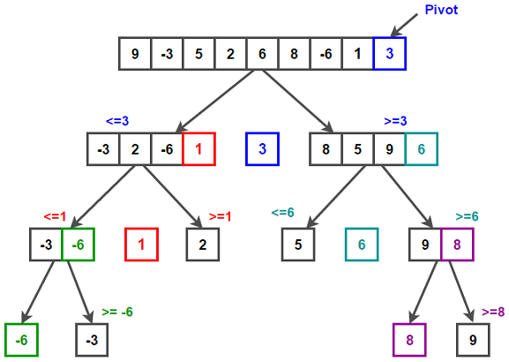
Quick Sort
Source: https://www.techiedelight.com/es/quicksort/

Slide 27
Quick Sort
Why is the worst case time complexity for quicksort O(n²)?
In the worst case scenario, every element in the array will all be lesser than pivot or all greater than pivot, and if this happens for the subarrays as well, it will take n+(n-1)+(n-2)+...1 comparisons, which is O(n²).
How to minimise the probability of this happening?
The optimal pivot should be the median. However, it is difficult to find the median, because you need to know the value of all elements.
Hence, one realistic method is to select a random pivot from the array. This works because it is statistically more likely for the random pivot to be close to the median, which will ensure a somewhat equal spread of left and right.

Slide 28
Quick Sort - Code
def quick_sort(arr):
if len(arr) <= 1:
return arr
mid = (low + high) // 2 # let pivot be the middle element
left, middle, right = [], [], []
for num in arr:
if num == arr[mid]:
middle.append(num)
elif num < arr[mid]: # is lesser than pivot
left.append(num)
else: # is greater than pivot
right.append(num)
return quick_sort(left) + middle + quick_sort(right)

Slide 29
Merge Sort
Merge Sort divides the array into smaller subarrays until it cannot be divided anymore, then merging the two sorted subarrays repeatedly.
Time complexity: O(n log n)

Slide 30
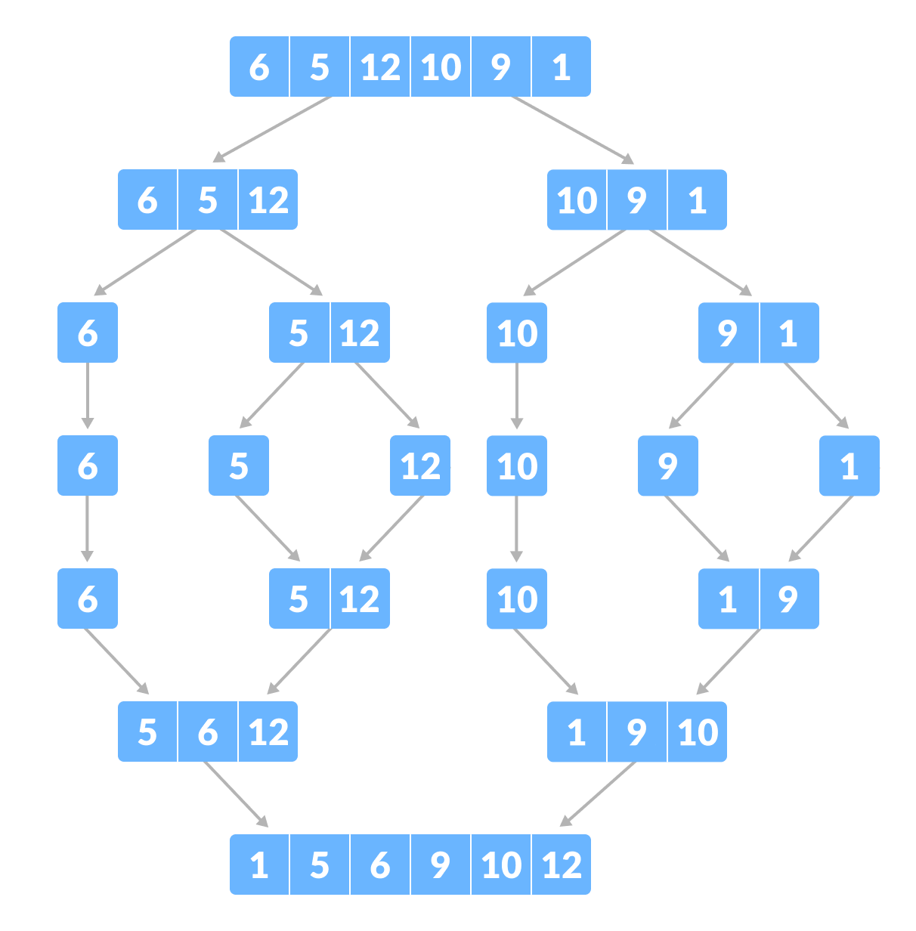
Merge Sort
Source: https://www.programiz.com/dsa/merge-sort

Slide 31
Merge Sort - Code
def merge(left, right):
merged_list = []
i = j = 0
while i < len(left) and j < len(right):
if left[i] < right[j]:
merged_list.append(left[i])
i += 1
else:
merged_list.append(right[j])
j += 1
merged_list += left[i:]
merged_list += right[j:]
return merged_list
def merge_sort(arr):
if len(arr) <= 1:
return arr
mid = len(arr)//2
left = merge_sort(arr[:mid])
right = merge_sort(arr[mid:])
return merge(left, right)

Slide 32
Theory Questions
Explain one advantage of using merge sort over insertion sort.
Merge sort is quicker than insertion sort as merge sort has a time complexity of O(n log n) compared to insertion sort O(n²) time complexity.
Explain one advantage of using insertion sort over merge sort.
Insertion sort is more memory efficient compared to merge sort as merge sort incurs additional memory costs from recursive calls, which uses an implicit stack, while insertion sort is implemented iteratively, and hence is more memory efficient.

Slide 33
Theory Questions
Explain one advantage of using merge sort over insertion sort.
Merge sort is quicker than insertion sort as merge sort has a time complexity of O(n log n) compared to insertion sort O(n²) time complexity.
Explain one advantage of using insertion sort over merge sort.
Insertion sort is more memory efficient compared to merge sort as merge sort incurs additional memory costs from recursive calls, which uses an implicit stack, while insertion sort is implemented iteratively, and hence is more memory efficient.

Slide 34
Theory Questions
Explain one advantage of using merge sort over quicksort.
Quicksort has a worst case time complexity of O(n²) while it is O(n log n) for merge sort.
Explain one advantage of using quicksort over merge sort.
Quicksort is usually done in place while merge sort requires a list to store the stored subarrays, hence quicksort is more memory efficient compared to merge sort.

Slide 35
Theory Questions
Explain one advantage of using merge sort over quicksort.
Quicksort has a worst case time complexity of O(n²) while it is O(n log n) for merge sort.
Explain one advantage of using quicksort over merge sort.
Quicksort is usually done in place while merge sort requires a list to store the stored subarrays, hence quicksort is more memory efficient compared to merge sort.

Slide 36
Theory Questions
Implement binary search iteratively using pseudocode.

Slide 37
Theory Questions
FUNCTION binary_search(arr, target)
low = 0, high = LEN(arr) - 1
WHILE low <= high THEN
mid = (low + high) // 2
IF arr[mid] == target THEN
RETURN mid
ELSE IF target < arr[mid] THEN
high = mid - 1
ELSE
low = mid + 1
ENDIF
ENDWHILE
ENDFUNCTION

Slide 38
Stack
Stack is a data structure which supports two operations, push and pop.
Stack follows the first in last out principle (FIFO). The first element to be pushed into the stack is the last element to be popped out of the stack.
Stack can be implemented with static memory or dynamic memory.

Slide 39
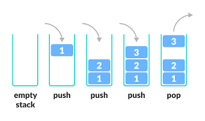
Stack
Source: https://www.programiz.com/dsa/stack

Slide 40
Stack
To implement a dynamic stack using arrays, just use list append and pop to perform push and pop operations respectively.

Slide 41
Static Stack - Code
class Stack: def pop(self):
def __init__(self, max_size): if self.top == -1:
self.max_size = max_size print("Pop failed. Stack is empty.")
self.stack = [None for i in range(self.max_size)] return
self.top = -1 temp = self.stack[self.top]
self.stack[self.top] = None
def push(self, val): self.top -= 1
if self.top == self.max_size - 1: return temp
print("Push failed. Stack is full")
return
self.top += 1
self.stack[self.top] = val

